Slide 3
TDD (Get Permission)

Slide 4
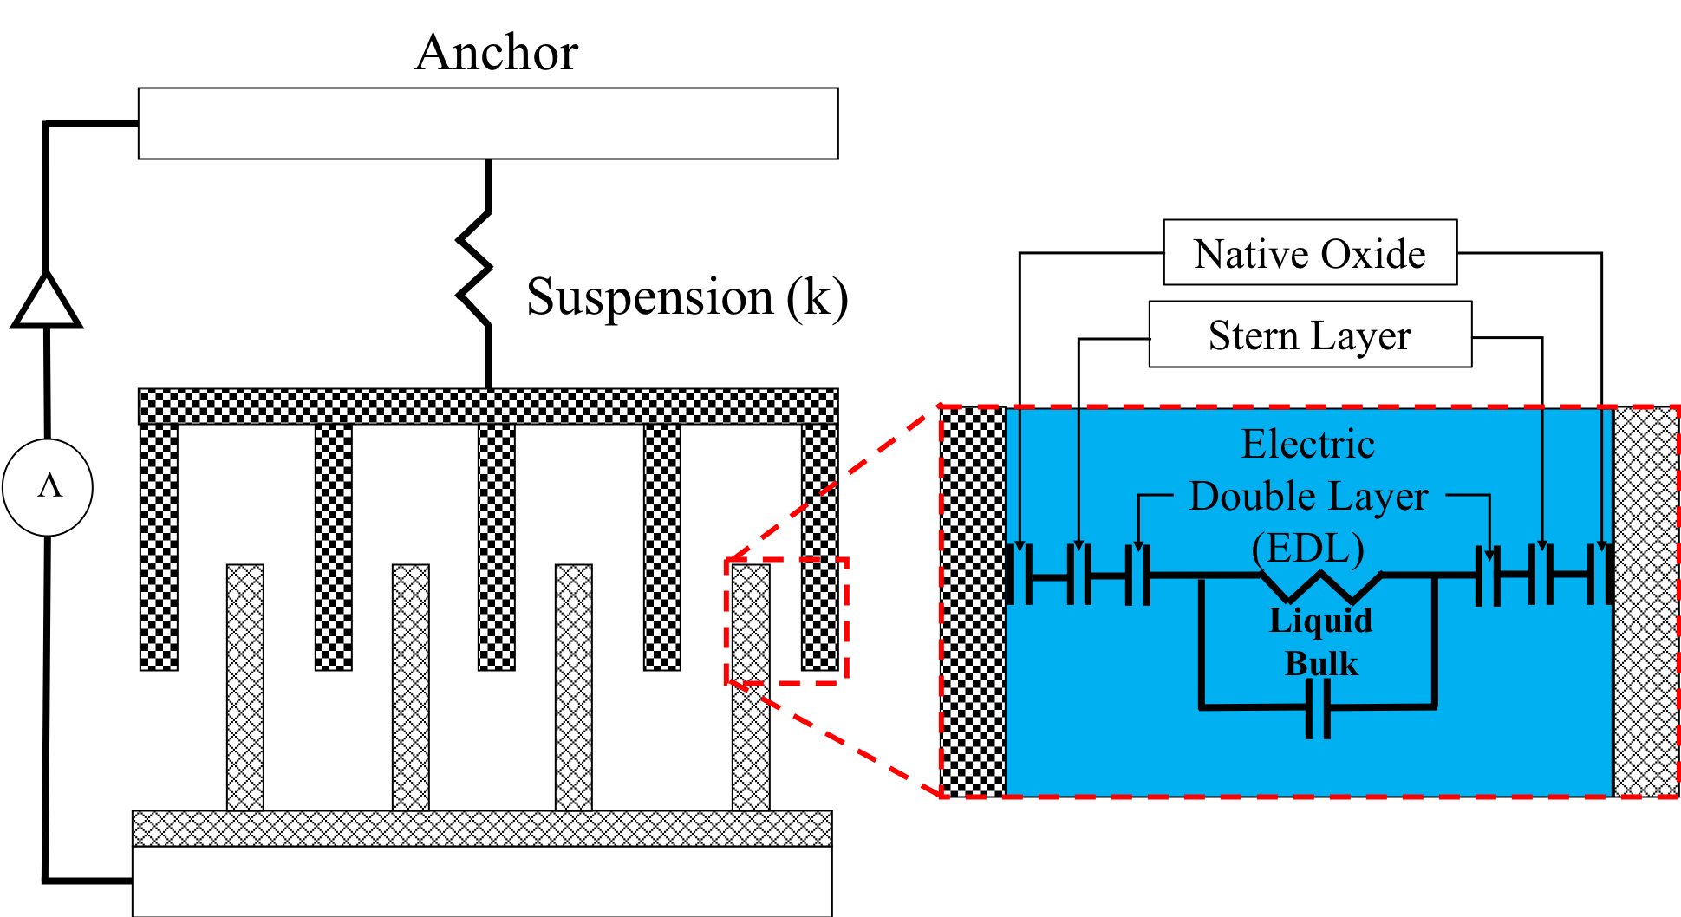
Comb-drive Finger to Parallel Schematic (Get Permission)

Slide 5
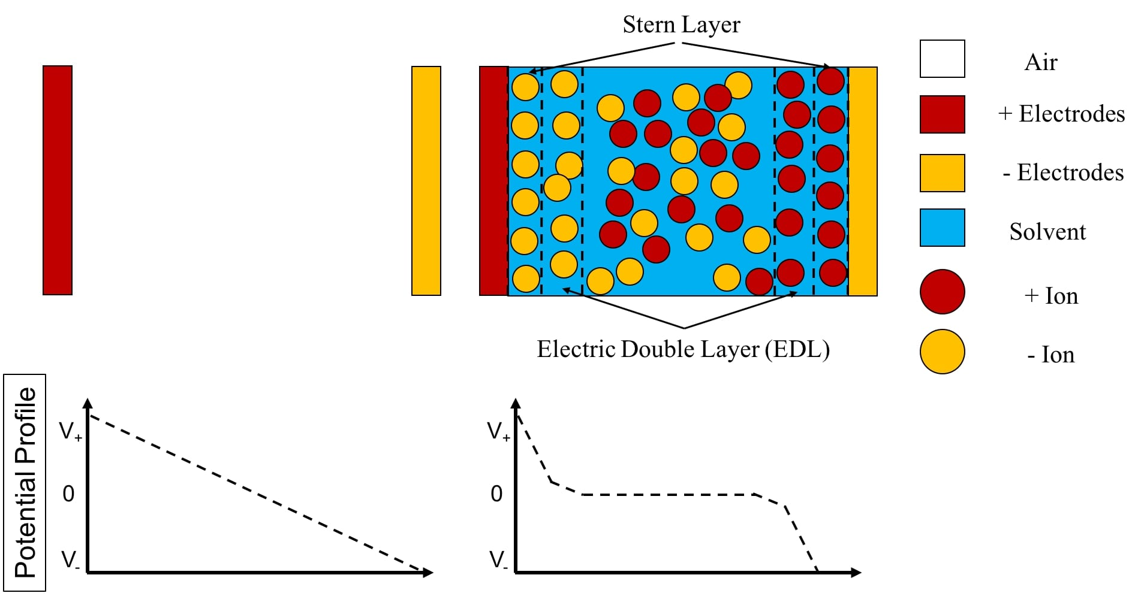
Potential Profile DC Air Liquid (Get Permission)

Slide 6
First Vikram Design (Get Permission)

Slide 7
Displacement Attenuation (Get Permission)

Slide 8
Second Vikram Design (Get Permission)

Slide 9
Displacement No Attenuation (Get Permission)

Slide 10
Cell Force (Get Permission)

Slide 11
Design 2 Fabrication Steps
1. DRIE Silicon Etch
4. Parylene Deposition
2. Metal evaporation and patterning
5. Parylene Patterning and Final Oxide Etch
3. Oxide Etch

Slide 12
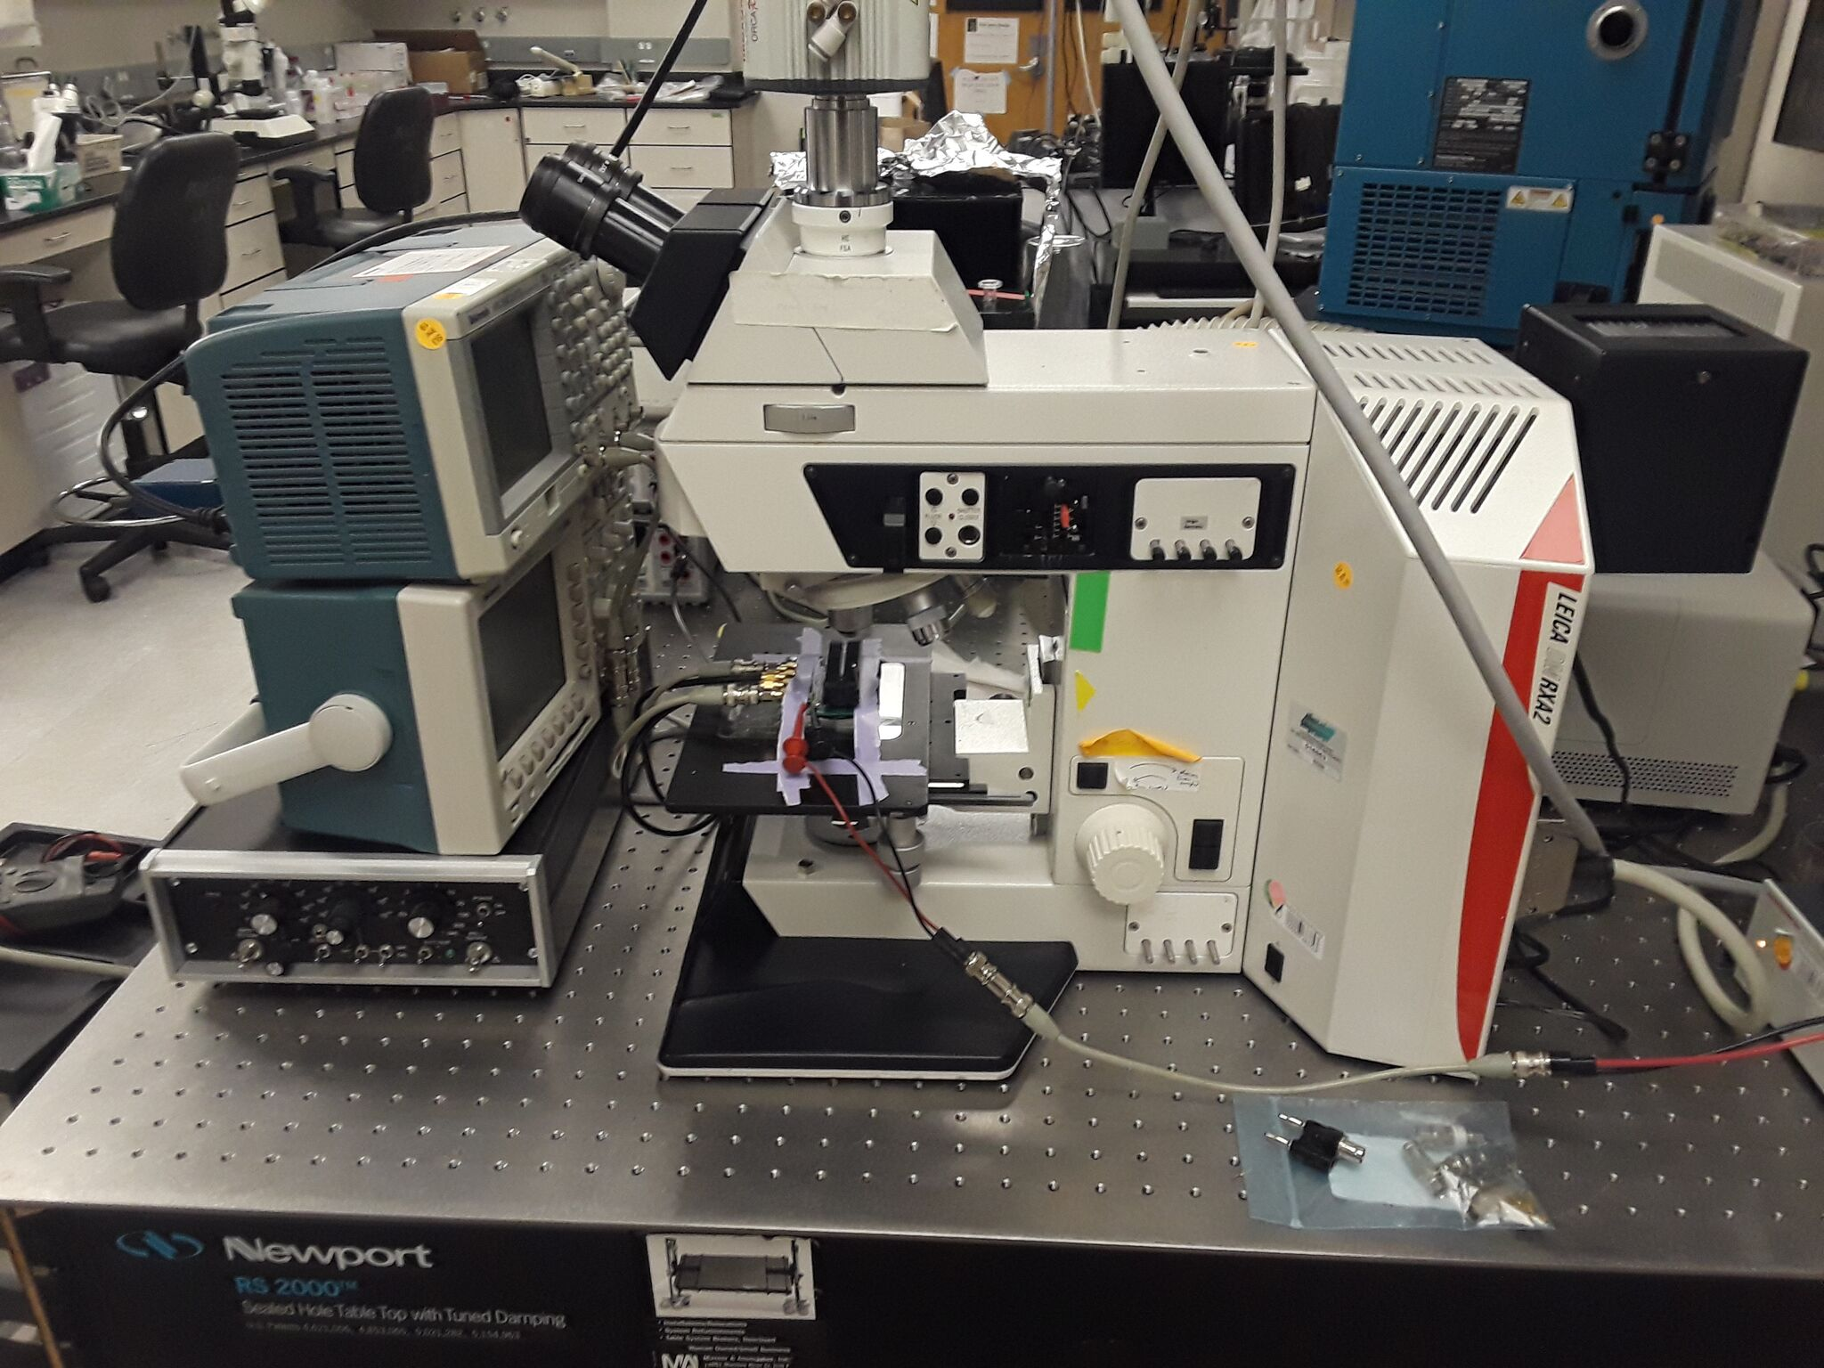
PCB_No_DIP
Connected and Mounted PCB

Slide 13
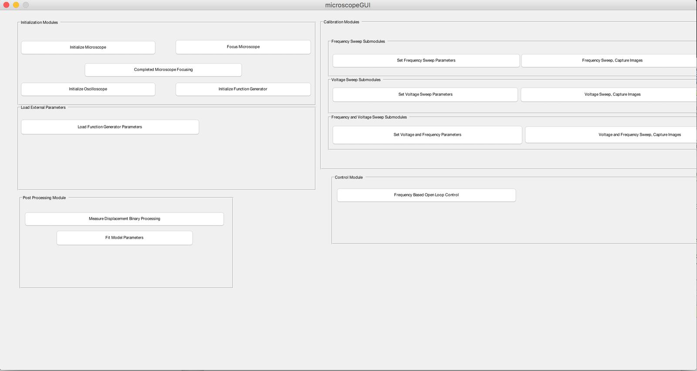

Slide 14
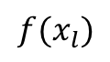
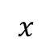
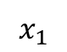
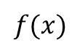
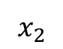
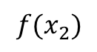
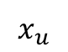
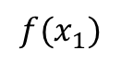
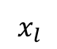
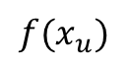
Golden Section Figure
$$f(x_{2})$$
$$f(x_{1})$$
$$f(x)$$
$$f(x_{l})$$
a
$$f(x_{u})$$
b
$$x$$
$$x_{l}$$
$$x_{2}$$
$$x_{1}$$
$$x_{u}$$

